Slide 1
LAKHEE AI : India's AI-Powered Procurement Platform for Fertilizers & Agrochemicals
CAPSTONE PROJECT
Presented By:
Student Name- Bhabarnab Hazarika
College Name- Assam Agricultural University, Jorhat
Department - Agriculture
4. AICTE ID : STU6a6689c1cc8771785104833

Slide 2
OUTLINE
Problem Statement
Proposed System/Solution
System Development Approach (Technology Used)
Algorithm & Deployment
Result
Conclusion
Future Scope
References

Slide 3
Problem Statement
Farmers often face difficulty in obtaining fertilizers and agrochemicals when they are urgently required, especially during sowing periods and pest or disease outbreaks.
Localized shortages of agricultural inputs
Uneven distribution of supplier inventory
Difficulty finding nearby suppliers with required products
Delayed deliveries during peak agricultural seasons
Lack of real-time information about stock availability
Price variation among suppliers
Risk of purchasing unverified or counterfeit agricultural inputs
These problems can result in delayed farm operations, increased procurement costs and potential crop losses.

Slide 4
Proposed Solution
LAKHEE – KHET KI DOST is a AI POWERED- geo-spatial procurement matching platform that connects farmers with verified agricultural-input suppliers.
The system will:
Allow suppliers to register products, stock, prices and locations.
Allow farmers to post their fertilizer or agrochemical requirements.
Match farmers with suitable suppliers based on product, quantity and location.
Identify exact products or verified chemical equivalents.
Notify nearby suppliers about urgent requirements.
Track orders from request to delivery.
Provide an admin system for supplier and product verification.

Slide 5
System Approach
Step 1: Farmer enters agricultural-input requirement.
↓
Step 2: Python application receives the request.
↓
Step 3: Requirement is processed using Gemini 3.6 Flash.
↓
Step 4: The AI analyses the product, crop and requirement information.
↓
Step 5: Relevant supplier/product information is identified.
↓
Step 6: LAKHEE generates an understandable response.
↓
Step 7: Farmer receives procurement assistance.

Slide 6
Technology Used
Programming Language
Python
Python is used for developing the complete application logic and integrating the AI model.
Development Platform
IBM Bob
IBM Bob is used to develop and build the LAKHEE application.
Artificial Intelligence
Gemini 3.6 Flash
The Gemini 3.6 Flash model provides the AI capabilities required to understand farmer requirements and generate relevant responses.
Application Flow
Farmer → LAKHEE → Python → Gemini 3.6 Flash → Response

Slide 7
Algorithm
The system follows an AI-assisted requirement-processing approach.
Input
Farmer's query
Crop information
Required input
Quantity
Location
Urgency
Processing
Receive farmer input.
Extract relevant requirements.
Send the requirement for AI processing.
Gemini 3.6 Flash analyses the input.
Identify relevant product/supplier information.
Generate a suitable response.
Display the result to the farmer

Slide 8
Deployment
The LAKHEE application is developed using IBM Bob and implemented using Python.
Application Architecture
User Interface
↓
Python Application
↓
Gemini 3.6 Flash
↓
AI-Based Requirement Processing
↓
Generated Response
Key Deployment Characteristics
Python-based application
AI-assisted processing
Simple farmer-oriented interface
Internet-enabled Gemini interaction
Designed for agricultural procurement assistance

Slide 9
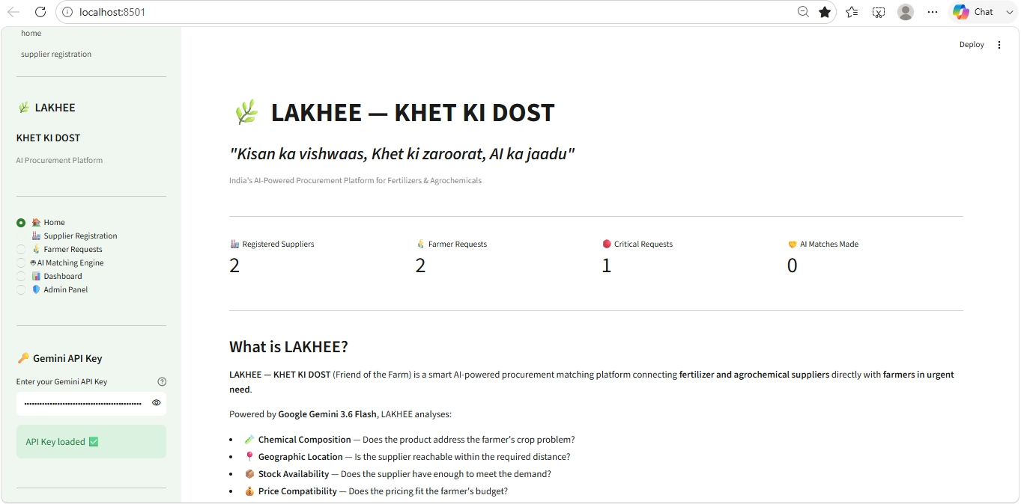
Result
.

Slide 10
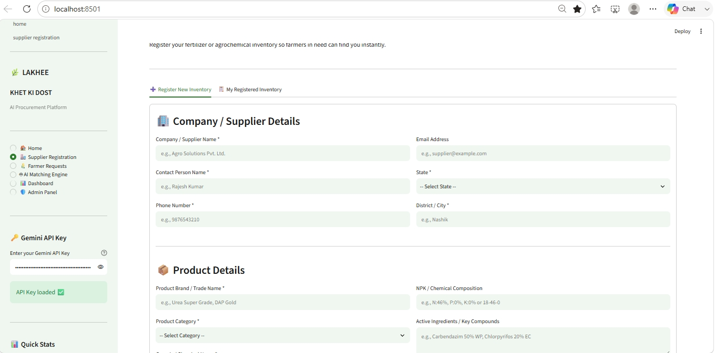
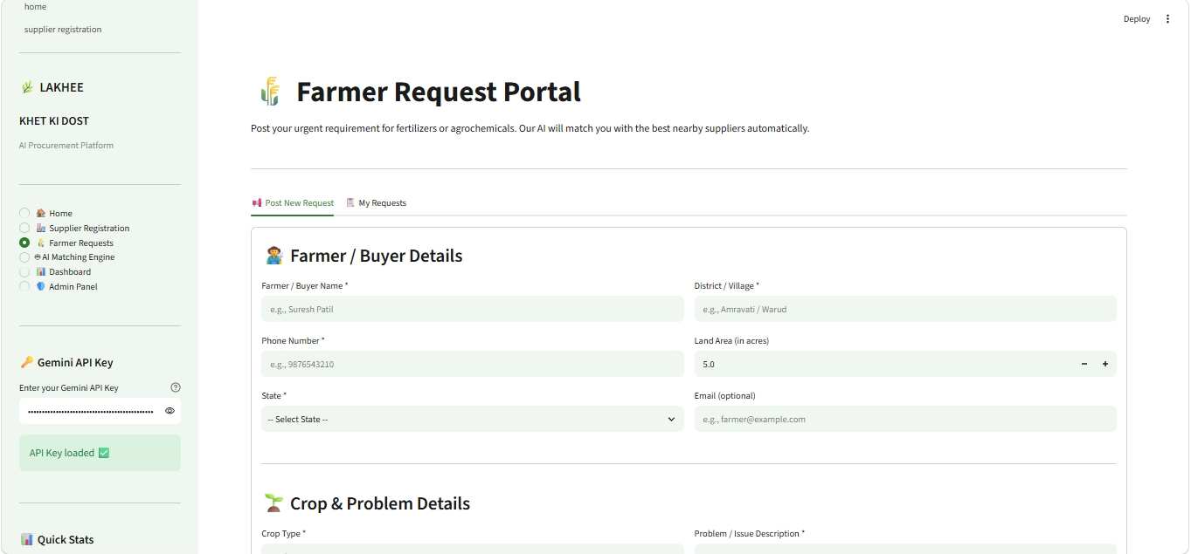
Result
.

Slide 11
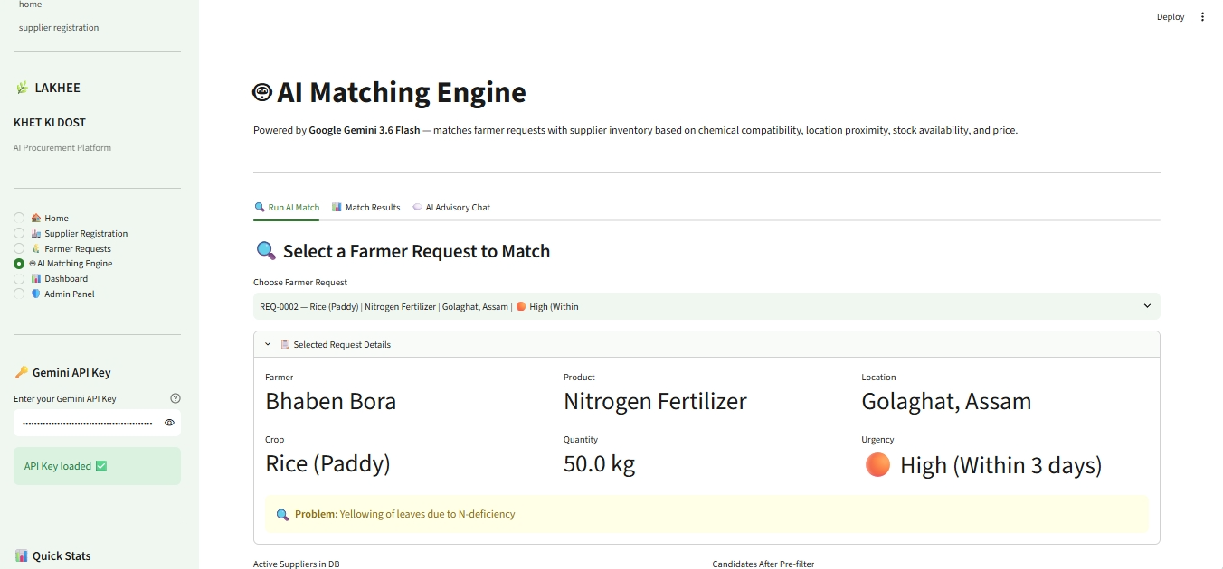
Result
.

Slide 12
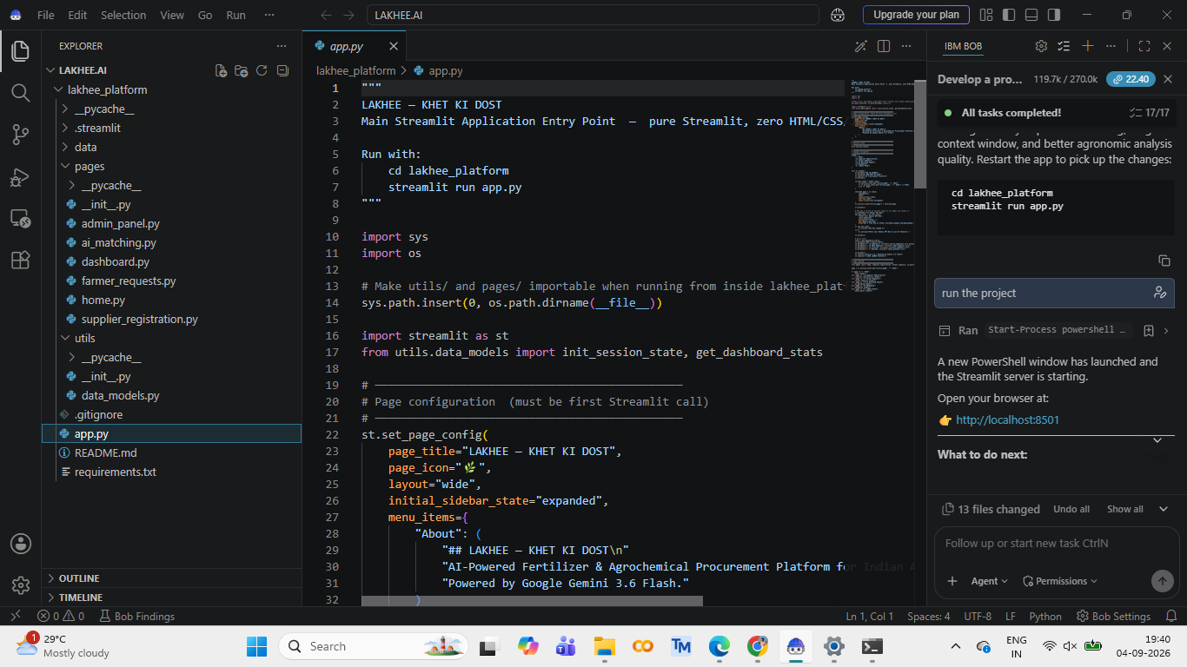
Result
.

Slide 13
Conclusion
LAKHEE – KHET KI DOST was developed as an AI-powered agricultural procurement assistance platform.
The system combines:
Python-based application development
IBM Bob development environment
Gemini 3.6 Flash AI model
Farmer requirement processing
Agricultural-input procurement assistance
The developed prototype demonstrates the potential of Generative AI to make agricultural-input procurement simpler, faster and more accessible for farmers.

Slide 14
Future scope
The LAKHEE platform can be further enhanced by introducing:
GPS-based nearby supplier identification
Real-time supplier inventory integration
Real-time fertilizer and agrochemical price comparison
SMS and WhatsApp notifications
Regional-language support including Assamese
Voice-based interaction for farmers
Digital order and delivery tracking
Supplier license verification
AI-based demand forecasting
Regional agricultural-input shortage prediction
Integration with agricultural marketplaces and government platforms

Slide 15
References
IBM Bob – Application Development Platform
Python Documentation
Google Gemini / Gemini API Documentation
Relevant literature on Generative AI in Agriculture
Agricultural fertilizer and agrochemical management resources
Agricultural supply-chain and procurement management literature

Slide 16
Deployment link / github link
Github Link: https://github.com/bhabarnabhazarika2002-coder/LAKHEE.AI.git
Deployment:
https://lakheeai-jouhfibzkbsnpwshgck35r.streamlit.app/

Slide 17
THANK YOU

